Slide 1

Predicting customer buying behaviour
Reviews Data Source: airlinequality.com

Slide 2
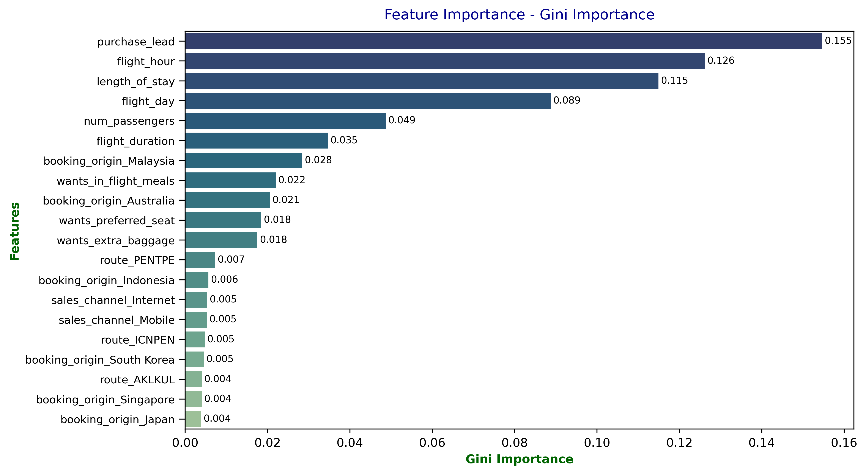
Results
Evaluation:
The most important feature was the purchase lead time, which indicates how far in advance a customer books their flight.
Other significant features included departure time, duration of stay, day of the week, number of passengers, and flight duration.
The Random Forest model achieved an accuracy of 86% when predicting cases where customers did not complete the booking and 54% for cases where bookings were completed.
The lower accuracy for predicting completed bookings is due to the limited training data; out of 50,000 cases, only around 7,000 involved completed bookings.
Greater accuracy could be achieved with more data on completed bookings.

